Slide 1
SECURE DATA HIDING IMAGEs USING STEGANOGRAPHY
CAPSTONE PROJECT
Presented By:
Student Name : KANIMOZHI S
College Name & Department : VELALAR COLLEGE OF ENGINEERING AND TECHNOLOGY & B TECH- INFORMATION TECHNOLOGY

Slide 2
OUTLINE
Problem Statement
Technology used
Wow factor
End users
Result
Conclusion
Git-hub Link
Future scope

Slide 3
Problem Statement
In the digital era, data security and confidentiality have become major concerns due to the increasing risks of unauthorized access and cyber threats. Traditional encryption methods provide security, but they often attract attention, making the data a target for attacks. Steganography offers an advanced approach by concealing sensitive information within digital images, ensuring that the existence of hidden data remains undetectable. This project aims to develop a secure and efficient steganographic technique for embedding and extracting confidential data in images while maintaining the visual integrity of the cover image. The solution will enhance data privacy, prevent unauthorized access, and be applicable in secure communication, digital watermarking, and covert data exchange.

Slide 4
Technology used
Programming Language: Python
Platform: Windows
Libraries Used:
OpenCV (cv2): For image processing
System Requirements
Operating System: Windows 10/11
Processor: Intel Core i3 or higher
RAM: Minimum 4GB (Recommended: 8GB)
Storage: At least 500MB of free space
Python Version: 3.7 or higher

Slide 5
Wow factors
🔒 "Triple-Layer Security: Encrypted, Invisible, and Passcode-Protected!"
This steganography project goes beyond traditional data hiding by implementing a three-layer security approach:
1️⃣ Invisible Data Embedding – The secret message is hidden within pixel values of an image, making it undetectable to the human eye. 2️⃣ Custom Encryption Mapping – The message is encoded using a unique ASCII-based transformation for added security. 3️⃣ Passcode Authentication – Even if someone extracts the image, decryption is impossible without the correct passcode.
✅ Advantage: Unlike conventional cryptography, this technique ensures that even if attackers gain access to the image, they won’t suspect any hidden data, making it a highly secure and covert method of communication.

Slide 6
End users
Government Agencies & Law Enforcement
Used for secure communication and covert information exchange.
Helps in intelligence gathering and classified data protection.
Journalists & Whistleblowers
Allows secure sharing of sensitive information while avoiding detection.
Essential for protecting confidential sources and reports.
Corporate & Business Sectors
Protects trade secrets and confidential business data.
Helps in secure internal communication without exposure to competitors.
Cybersecurity & Ethical Hackers
Helps in testing security vulnerabilities in digital communications.
Used for securely embedding forensic data for investigation purposes.
Military & Defense
Secure exchange of classified documents in encrypted image formats.
Helps in preventing interception by unauthorized entities.
Individuals Concerned with Privacy
Personal data protection in images from cyber threats.
Enables private communication without detection in social platforms.

Slide 7
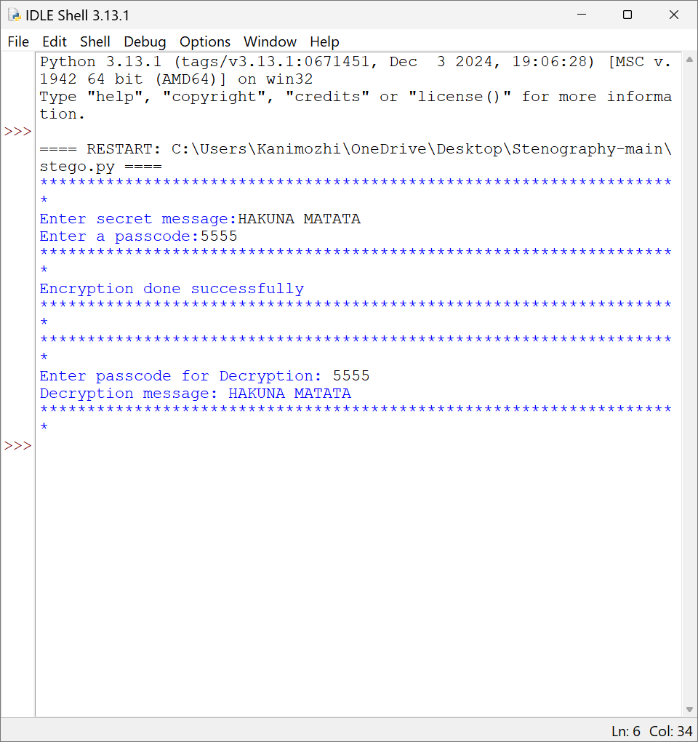
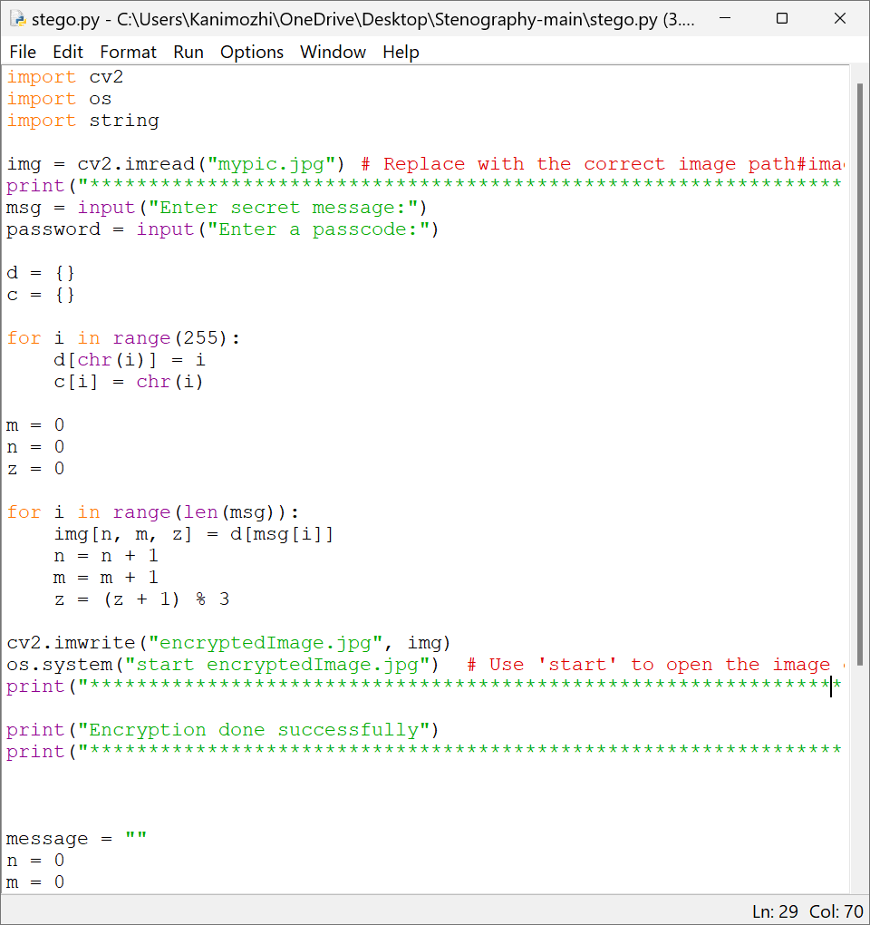
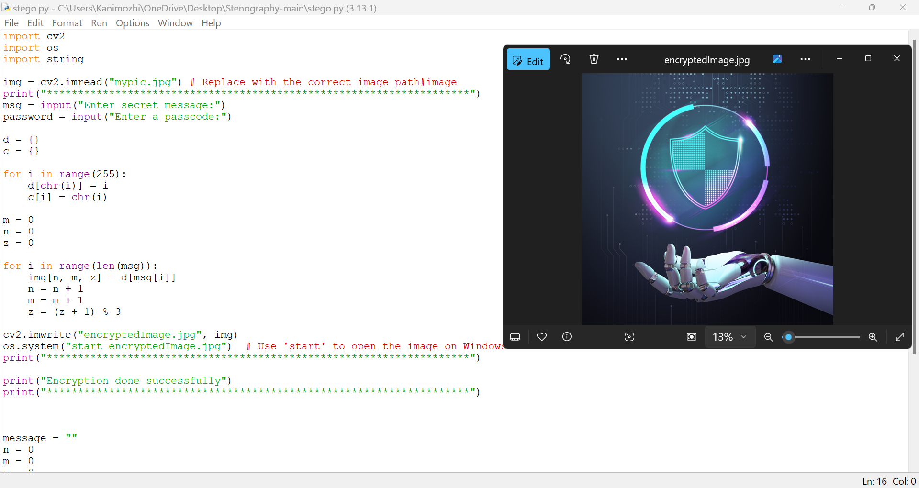
Results

Slide 8
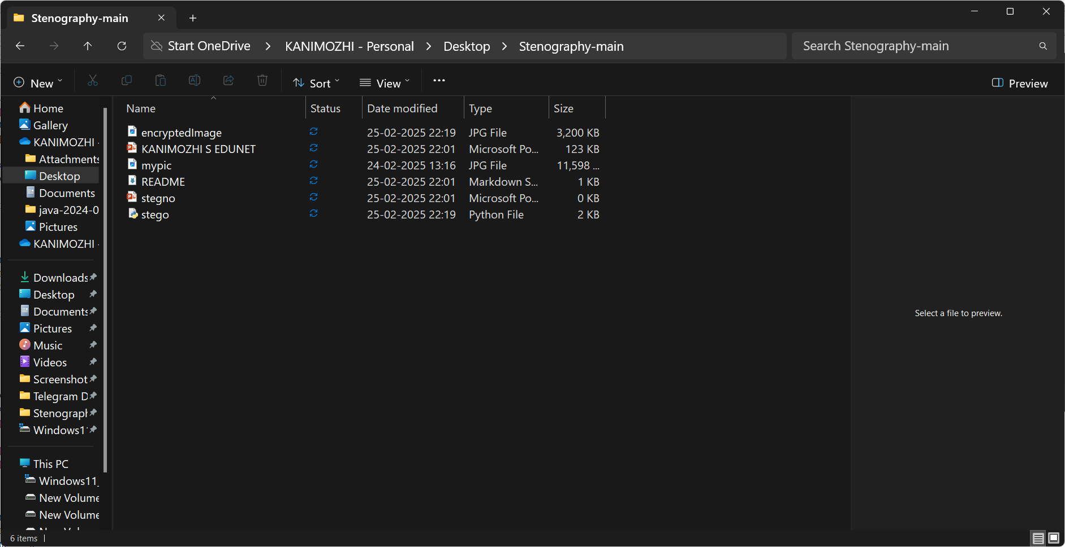
Conclusion
Steganography is a powerful technique for secure data hiding, ensuring confidentiality by embedding secret messages within images. This project successfully demonstrates image-based steganography, where a message is encrypted and stored in an image using pixel modifications. Only users with the correct passcode can retrieve the hidden data, enhancing security. This method provides a robust approach to secure communication, preventing unauthorized access and ensuring data privacy. With further advancements, it can be applied in cybersecurity, digital forensics, and confidential data transmission.

Slide 9
GitHub Link
https://github.com/skanimozhi48/EDUNET-CYBERSECURITY

Slide 10
Future scope(optional)
Enhanced Security Algorithms – Future research will focus on integrating AI and quantum cryptography to enhance the security of steganographic techniques, making it nearly impossible for attackers to detect hidden data.
Improved Data Capacity – Advancements in image processing and deep learning will allow higher data embedding capacity without compromising image quality or detectability.
Real-Time Steganography – Development of real-time secure communication using steganography in video conferencing and live streaming applications for military and confidential communication.
Integration with Blockchain – Combining steganography with blockchain can ensure secure data transmission with decentralized authentication, enhancing privacy in financial and governmental applications.
Steganography in Cybersecurity – Future cybersecurity solutions may incorporate steganography to securely exchange encryption keys, preventing data leaks and unauthorized access in sensitive networks.

Slide 11
THANK YOU

